Slide 1
IMU 9DoF LSM9DS1
INERTIAL MEASUREMENT UNIT

Slide 2

Specs
9DoF = 3 axes/sensor (3 sensors)
±2/±4/±8/±16 g linear acceleration range
±4/±8/±12/±16 gauss magnetic range
${10}^{4}$ gauss = 1 tesla
±245/±500/±2000 °/sec angular rate full scale
-40 Temperature sensor

Slide 3

Max ratings
Supply voltage: -0.3 v to 4.8 v
Accelerometer: 3000 g for 0.5 ms
1000 gauss
${10}^{4}$ gauss = 1 tesla
Sensitive to electrostatic discharge

Slide 4

Accuracy
Accelerometer
Linear acceleration zero-g level offset accuracy: +-90 mg
Gyroscope:
Angular rate typical zero-rate level: +-30 dps
1000 gauss
${10}^{4}$ gauss = 1 tesla
Sensitive to electrostatic discharge

Slide 5
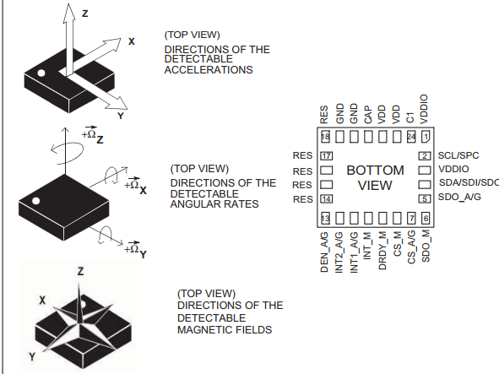
Add a Slide Title - 1

Slide 6
Connecting the IMU
SPI / I2C serial interfaces
Matlab
Supply voltage : 1.9 V to 3.6 V
16-bit data output

Slide 7
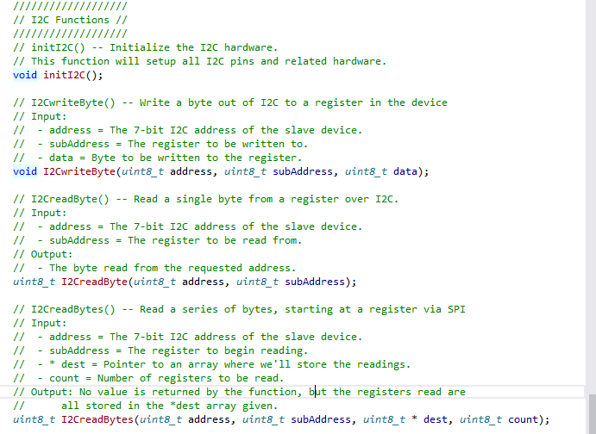

Slide 8
Retrieving values
// calcGyro() -- Convert from RAW signed 16-bit value to degrees per second
// This function reads in a signed 16-bit value and returns the scaled
// DPS. This function relies on gScale and gRes being correct.
// Input:
//- gyro = A signed 16-bit raw reading from the gyroscope.
float calcGyro(int16_t gyro);
// calcAccel() -- Convert from RAW signed 16-bit value to gravity (g's).
// This function reads in a signed 16-bit value and returns the scaled
// g's. This function relies on aScale and aRes being correct.
// Input:
//- accel = A signed 16-bit raw reading from the accelerometer.
float calcAccel(int16_t accel);
// calcMag() -- Convert from RAW signed 16-bit value to Gauss (Gs)
// This function reads in a signed 16-bit value and returns the scaled
// Gs. This function relies on mScale and mRes being correct.
// Input:
//- mag = A signed 16-bit raw reading from the magnetometer.
float calcMag(int16_t mag);

Slide 9
Possibilities:
Rewriting the libraries in C
Using Matlab’s I2C functions to retrieve data
Learn step-by-step, sensor by sensor is best

